Slide 1
Yashraj Dangre
HR Analytics Project :-
StriveStaff Solutions

Slide 2
Contents
Introduction to Data:-
Detail introduction to the data that we have used for the analysis.
Report :-
Created an insightful Human Resource analysis Report
Objective :-
Finding the reason behind attrition and reducing it
Data Insights :-
Understood the reasons behind the attrition of the employees
Final conclusion :-
Analyzed the data and provided some key points to retain the employees

Slide 3
Introduction :- here we have used the data of StriveStaff Solutions for our HR Analytics project. This data includes the information about employees attrition, their job role, Job Satisfaction rate, Salary ,tenure etc which can help to make the better analysis. Objective:- Analyzing the Data to find out the reason behind employee attrition. Understanding employee requirements to increase job satisfaction. Finding out which job role has the lowest satisfaction rate. Providing solution to retain the employees.

Slide 4
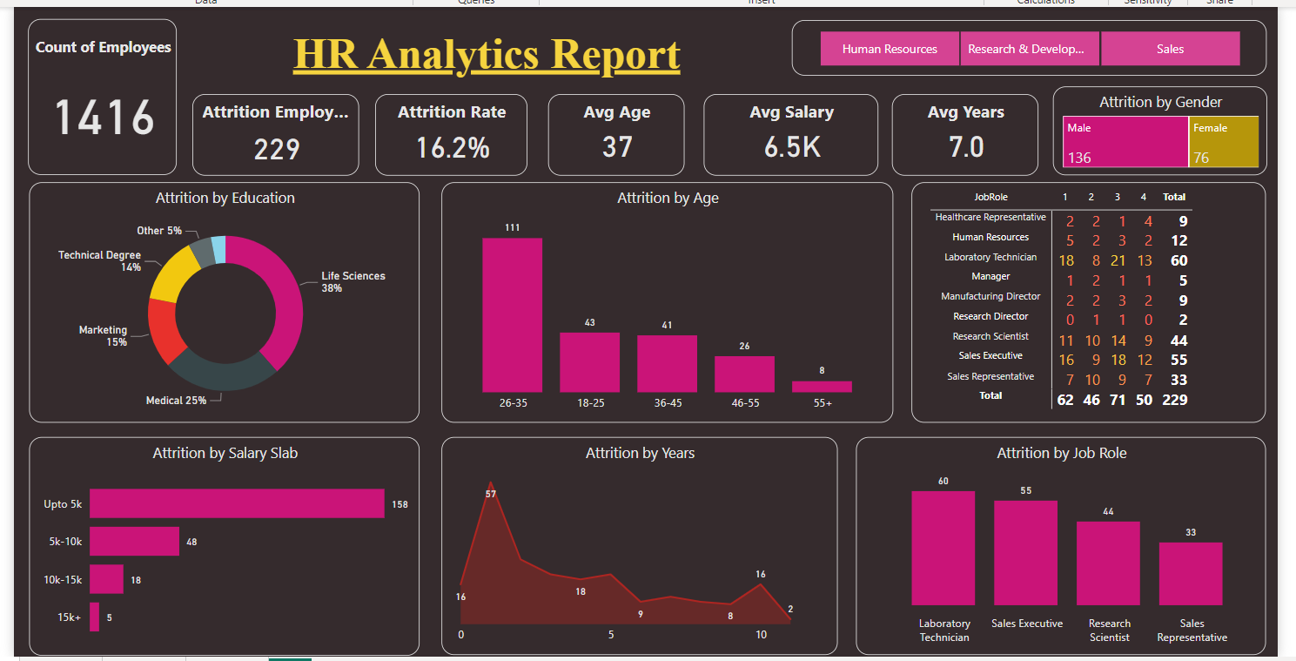
Report

Slide 5
Data Insights :- Total Count of Employee attrition :- 229 out of 1416 Avg salary of the employees :- 6.5k Identified key factors behind attrition. Improved the Hiring Process. found the least satisfying job roles. Understood the competitive salary requirement of the employees. Most employees leave the job within one year. Age 26-35 are most likely to switch the job.

Slide 6
Final Conclusion :- focus on laboratory technicians and sales Executives to increase their job satisfaction. Improve employee experience. Improve Hiring process by providing more competitive salary. Gain the trust of the employees to retain them for atleast more than 2 years. Make workforce more productive by increasing job satisfaction and providing incentives or bonuses.

